Slide 1


Segmentation Modeling
Michael Pomatto
Data 728

Slide 2

Weekly Objectives – Week Five
Cross-Industry Process for Data Mining (CRISP-DM)
Define your business objective.
Define the modeling approach and design a modeling process. This may include additional data that you choose to bring into your model in addition to files provided.
Investigate your data sources
Select which to use
Perform basic exploration of your data, validation, and cleaning.
Enrich your data.
Provide guidance on the validation of your data.
CRISP-DM Steps
Business Understanding
Data Understanding
Data Preparation

Slide 3
Classification and Behavioral Segmentation Modeling
Classification Modeling
One that attempts to draw some conclusion from observed values. This typically will take the form of one of two types:
Supervised – Training data is an input into a classification algorithm and compared against a known outcome. For example, classifying if an e-mail is spam or not based on previous examples.
Unsupervised – Commonly seen as clustering. This looks for anomalies or outliers.
Behavioral Segmentation Modeling
Dividing a heterogeneous market into relatively more homogenous segments based on certain parameters like geographical location, demographics, etc.
Purpose: Minimize risk by determining which products have the best chances for gaining a target market share.
Value: Allows you to reach a particular customer segment more effectively. It can also help retain customers.
Data 728 Approach
Classification
Focus heavier on supervised modeling
Bagging and Boosting models
Models: Decision Trees, CHAID, Bayesian, SVM
Behavioral Segmentation
Focus heavier on unsupervised modeling
Clustering evaluation and optimization
Models: K-Means and Two-Step
Notes:
Definitions are taken from Data Science Central; however, they are broadly accepted across the industry.

Slide 4
Datasets Provided – Segmentation Models
The dataset is simply a sample dataset representing different types of telephonic activity
CID: Customer identifier
Fixed Out: Land line phone calls
Mobile: Cellular
Broadband: Internet traffic (relative measurement)
PRC: Recovery phone calls (fixed, mobile, international)

Slide 5
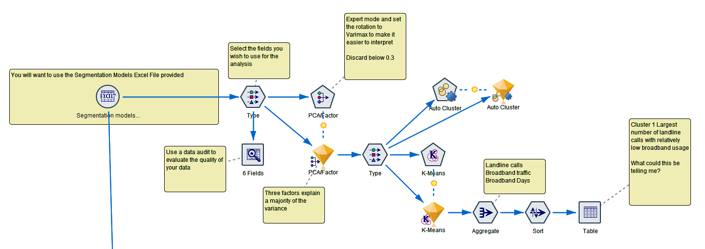
CRISP-DM Framework: Full Segmentation Model
Initial Model – Primary Component Analysis (PCA), no partition, no anomaly detection, auto clustering

Slide 6
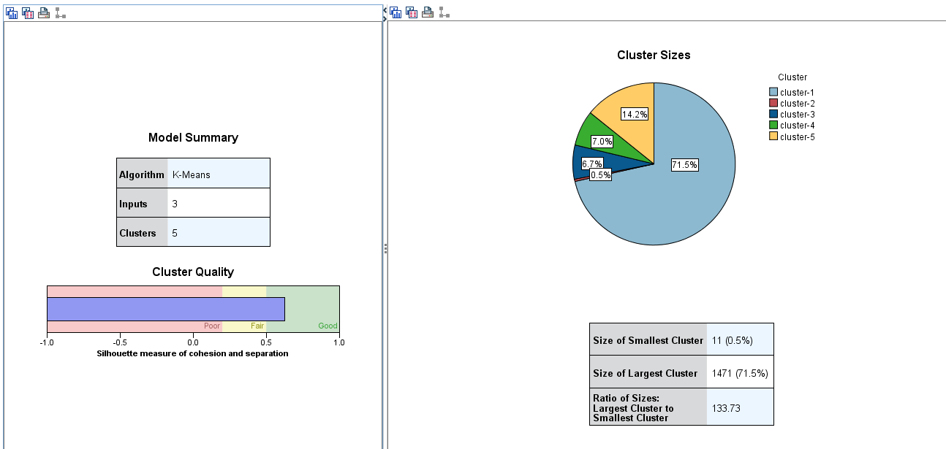
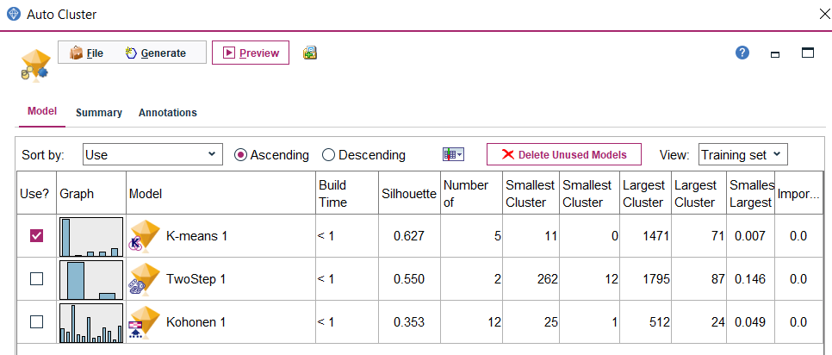
CRISP-DM Framework: Full Segmentation Model
Initial Model – Primary Component Analysis (PCA), no partition, no anomaly detection, auto clustering

Slide 7
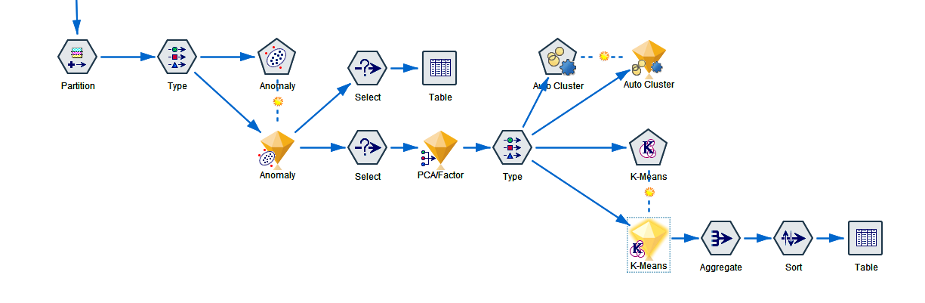
CRISP-DM Framework: Full Segmentation Model
Partition and Anomaly Detection Implemented

Slide 8
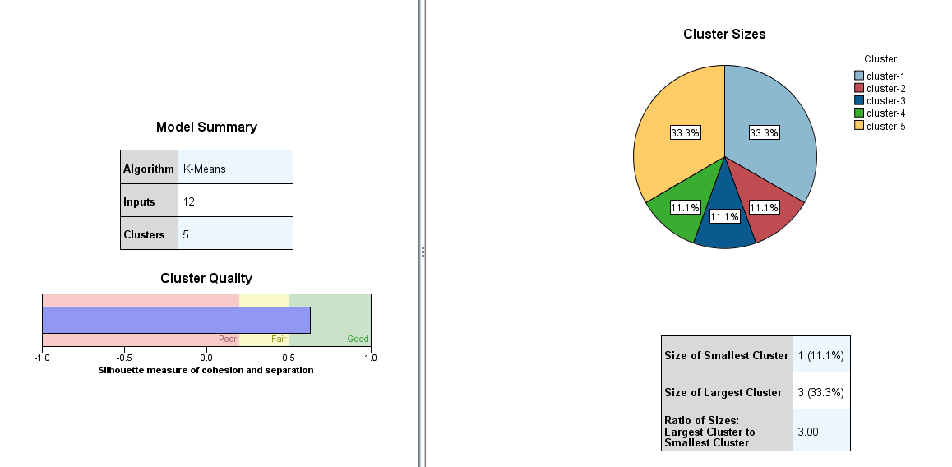
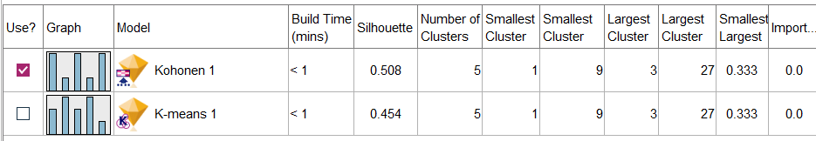
CRISP-DM Framework: Full Segmentation Model
Partition and Anomaly Detection Implemented

Slide 9
Weekly Objectives – Week Six
Cross-Industry Process for Data Mining (CRISP-DM)
Assess the internal cohesion and separation of the clustering solution
Examine the number of clusters and size of the clusters
Profile the revealed segments
Select the optimal cluster solution
Leave notes in your SPSS stream to document the model
CRISP-DM Steps
Modeling
Evaluation

Slide 10
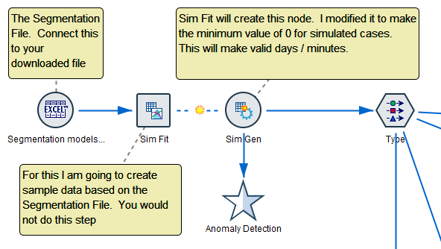
CRISP-DM Framework: Full Segmentation Model
Demonstration of creating simulated data
Refer to the Demonstration Stream

Slide 11
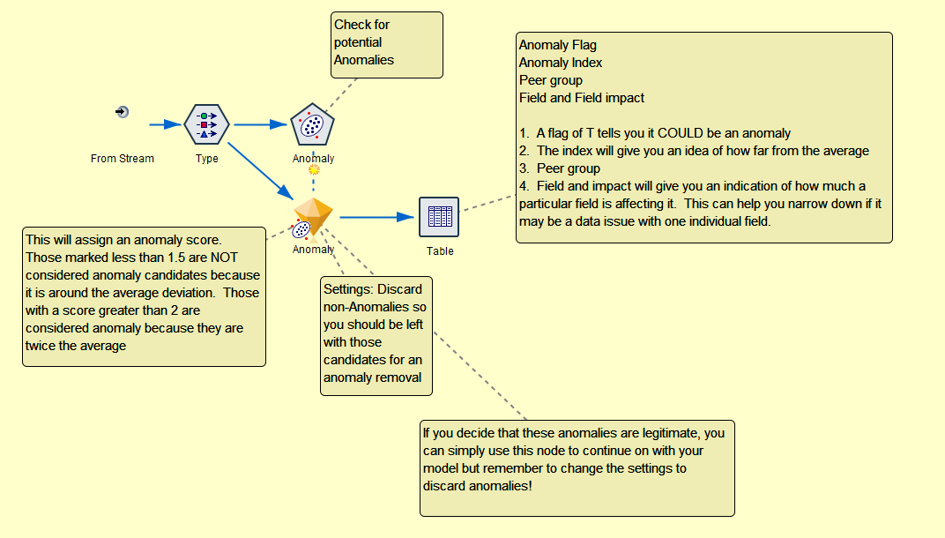
CRISP-DM Framework: Full Segmentation Model
Anomaly Detection and Removal

Slide 12
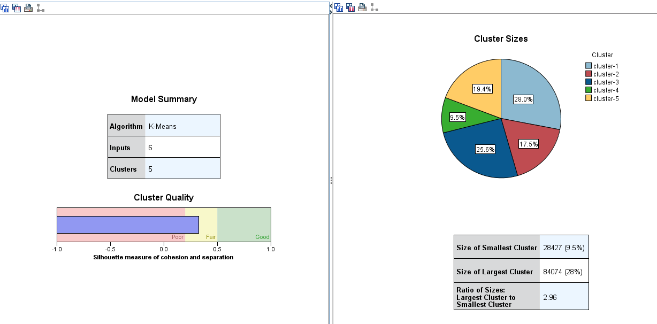
CRISP-DM Framework: Full Segmentation Model
Cluster Evaluation

Slide 13
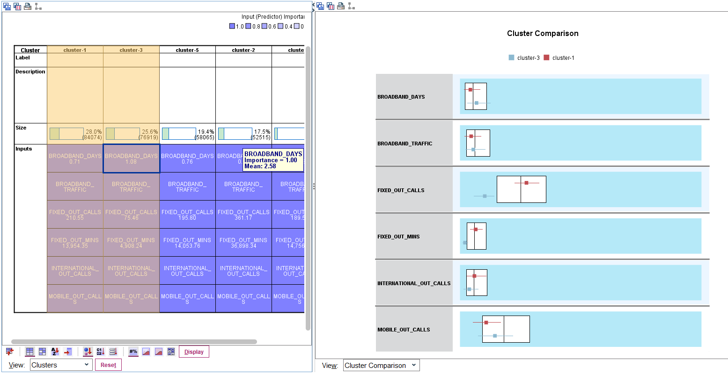
CRISP-DM Framework: Full Segmentation Model
Cluster Comparison

Slide 14
Weekly Objectives – Week Seven
Cross-Industry Process for Data Mining (CRISP-DM)
Deploy your final production model
CRISP-DM Steps
Deployment

Slide 15
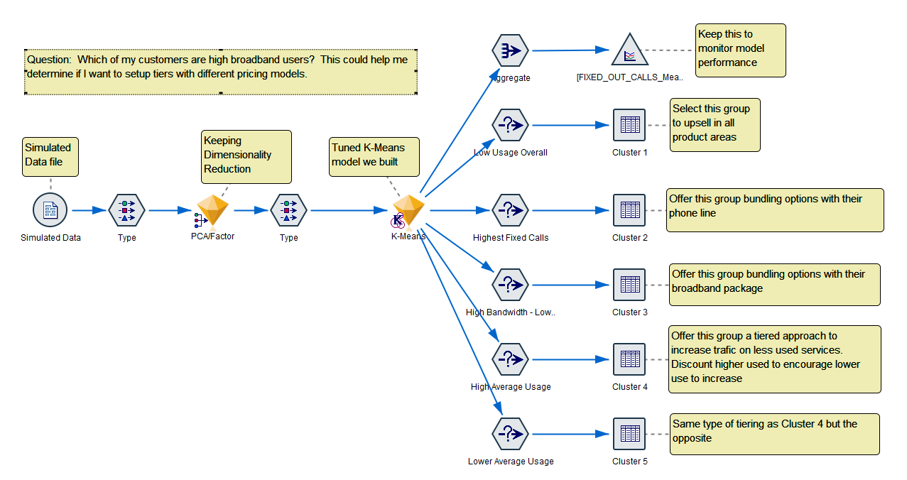
CRISP-DM Framework: Full Segmentation Model

